Slide 1

Modeling the Overall Energy in a Song: Linear Regression Approach
Presentation and Analysis By: Joey Gadbois
Code on GitHub: https://github.com/jgadbois17

Slide 2
Data Introduction
Variable | Data Type | Description
(Y) Energy | Numeric | Perceptual measure of intensity and activity
(1) Genre | Categorical | Genre of music
(2) Mode | Categorical | Modality of track: 1 = major, 0 = minor
(1) Tempo | Numeric | Overall beats per minute (BPMs)
(2) Danceability | Numeric | Measures how suitable the track is for dancing
(3) Loudness | Numeric | Overall loudness of a track in decibels (dB)
(4) Speechiness | Numeric | Detects the presence of spoken works in a track
(5) Acousticness | Numeric | Measures the acoustic sound of a track
(6) Liveness | Numeric | Detects presence of an audience in the recording
(7) Instrumentalness | Numeric | Predicts presence of vocals in the track
(8) Valence | Numeric | Measure of musical positivity conveyed by a track
(9) Duration | Numeric | Length of track in milliseconds
The data were scraped from Spotify’s Application Programming Interface (API)
The data consists of songs and audio features corresponding to each song

Slide 3
Research Questions
1. How can linear regression be implemented in order to understand what determines the overall energy of a track in the simplest manner?
2. What variable has the largest effect on the overall energy in a track?
3. Disregarding simplicity, are there any interactions in the data that contribute to understanding the energy in a track? If so, are they intuitive?

Slide 4
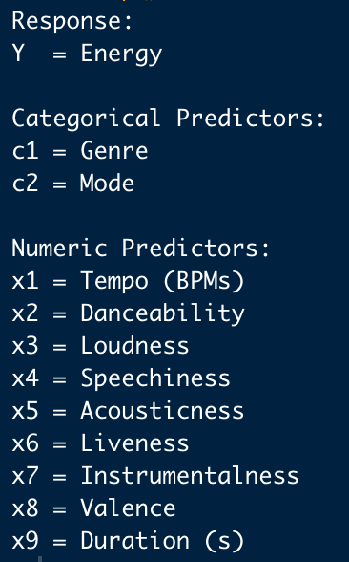
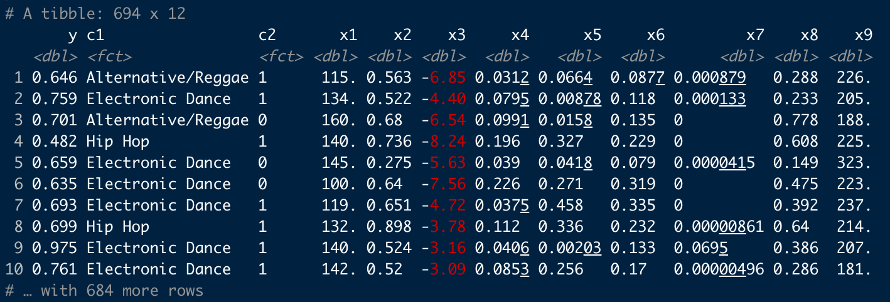
First Look at the Data
Notice the range of values for the variables, a lot of them are between 0 and 1
The values for Instrumentalness look to be significantly lower than all others that have that range
There are 5 groups for genres, Alternative/Reggae, Electronic Dance, Country, Hip Hop, and Pop
Note that there are a total of 694 observations

Slide 5
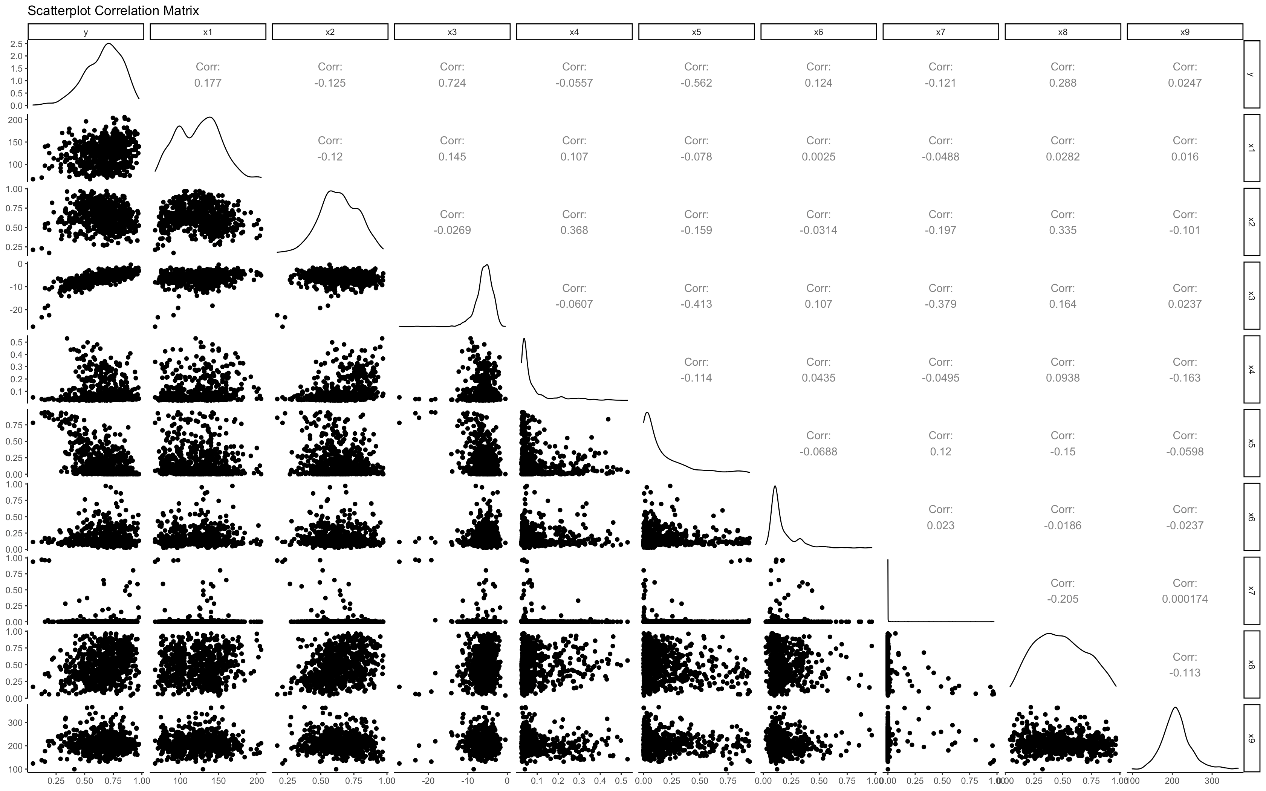
Before we Address the First Question:
Notable Correlations with the response variable:
corr(y, x3) = 0.724
corr(y, x5) = -0.562
Notice:
distribution of x7 looks to have mostly values that can be considered zero

Slide 6
Consider Research Question 1
Question:
How can linear regression be implemented in order to understand what determines the overall energy of a track in the simplest manner?
Proposed Solution:
Perform variable selection procedures to find an initial model
Reduce the initial model to ensure that all predictors are significant
Assess model assumptions to ensure the model is valid to use for inference

Slide 7
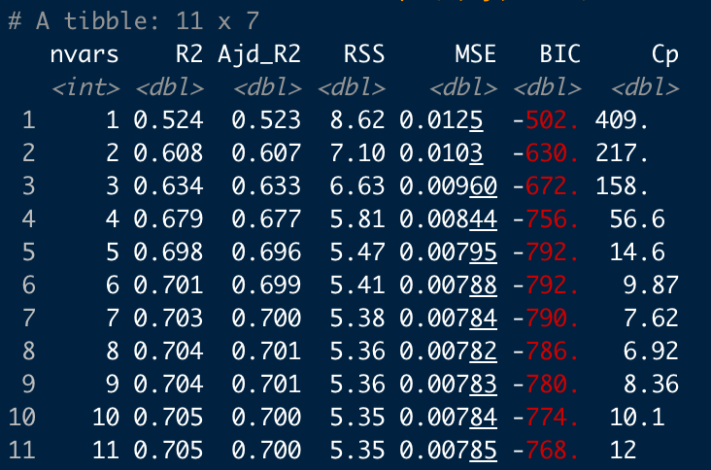
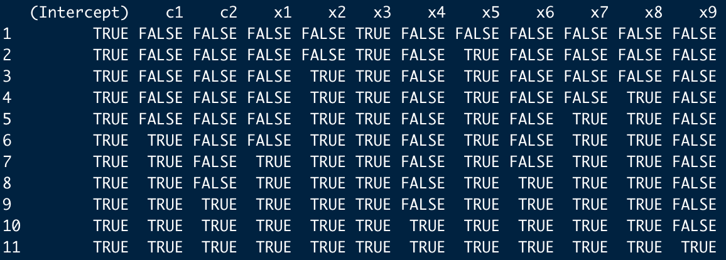
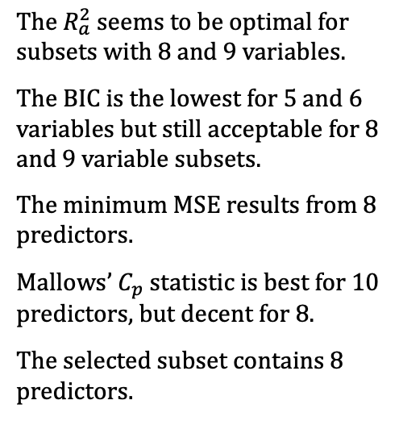

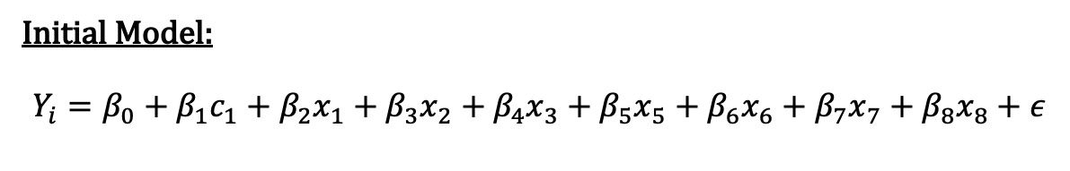
Variable Selection Procedures
The $R_{a}^{2}$ seems to be optimal for subsets with 8 and 9 variables.
The BIC is the lowest for 5 and 6 variables but still acceptable for 8 and 9 variable subsets.
The minimum MSE results from 8 predictors.
Mallows’ $C_{p}$ statistic is best for 10 predictors, but decent for 8.
The selected subset contains 8 predictors.
Selected Method:
Best Subsets Regression so comparisons can be made based on multiple criteria.
The 4 criteria considered were adjusted $R^{2}$, Bayesian Information Criterion, Mean Squared Error, and Mallows’ $C_{p}$ statistic to select an optimal starting model.
Initial Model:
$$Y_{i}=β_{0}+β_{1}c_{1}+β_{2}x_{1}+β_{3}x_{2}+β_{4}x_{3}+β_{5}x_{5}+β_{6}x_{6}+β_{7}x_{7}+β_{8}x_{8}+ε$$

Slide 8
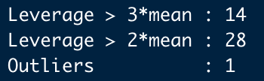
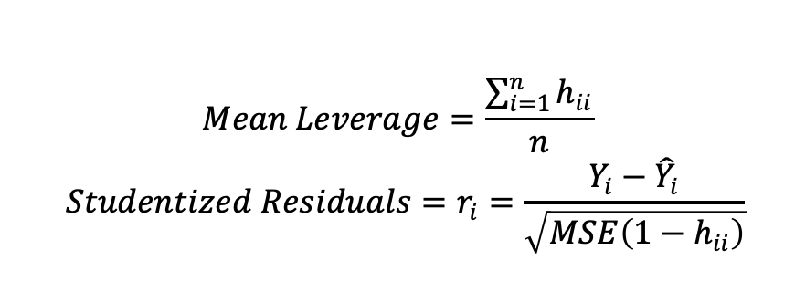
Checking for Influential Points
$$Mean Leverage=\frac{\sum_{i=1}^{n}{h_{ii}}}{n}$$
$$Studentized Residuals=r_{i}=\frac{Y_{i}−{\hat{Y}}_{i}}{\sqrt{MSE\left(1−h_{ii}\right)}}$$
The presence of influential points could cause naive assumptions that a model is not sufficient
Methods of identifying potential influential points in this project include the acknowledgement of leverages and outliers
Before any decisions are made, leverages that are both 2 and 3 times greater than the mean leverage are noted
Outliers are determined via studentized residuals, where the absolute value is greater than 3
Since the total number of leverages greater than twice the mean combined with outliers is very small relative to the size of the data, all 29 potential influential points will be dropped.

Slide 9
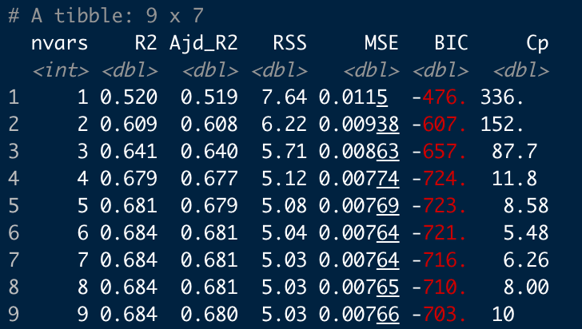
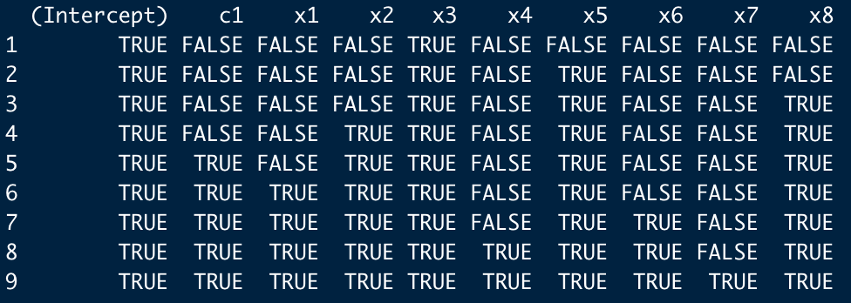
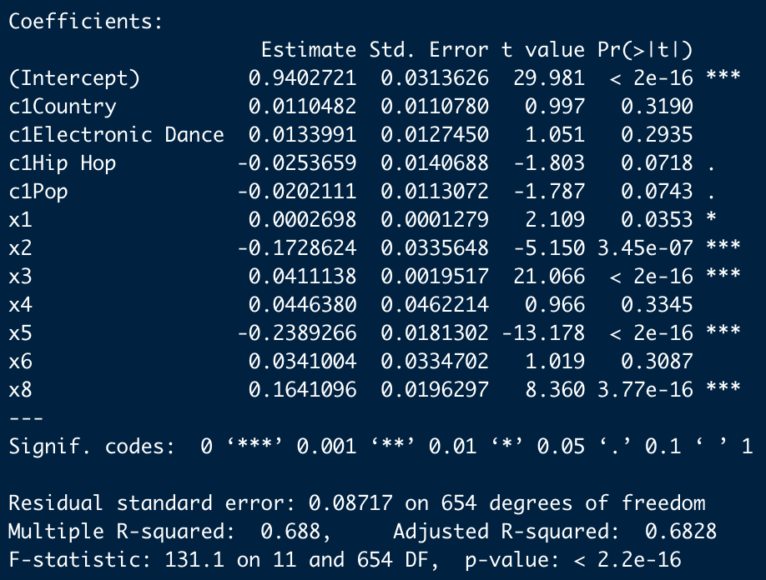
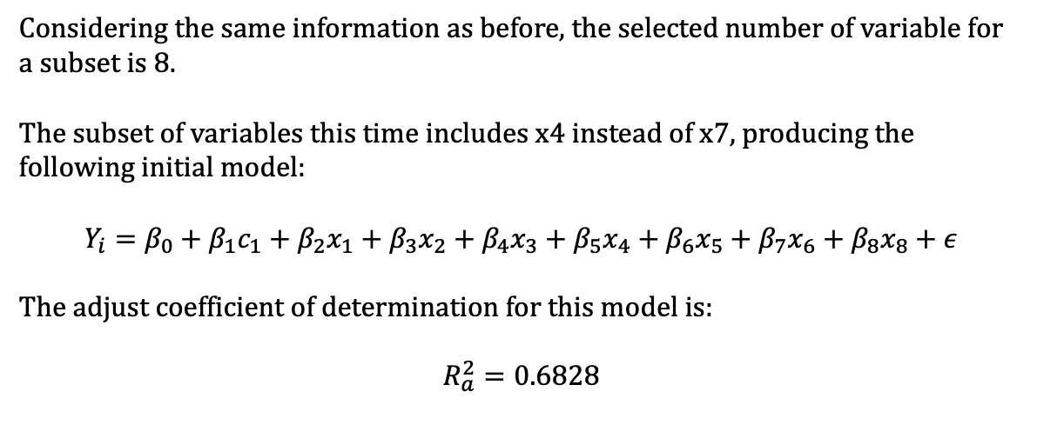
Best Subsets Regression Without Influential Points
Variable selection with best subsets regression is run again without the influential points.
Considering the same information as before, the selected number of variable for a subset is 8.
The subset of variables this time includes x4 instead of x7, producing the following initial model:
$$Y_{i}=β_{0}+β_{1}c_{1}+β_{2}x_{1}+β_{3}x_{2}+β_{4}x_{3}+β_{5}x_{4}+β_{6}x_{5}+β_{7}x_{6}+β_{8}x_{8}+ε$$
The adjust coefficient of determination for this model is:
$$R_{a}^{2}=0.6828$$

Slide 10
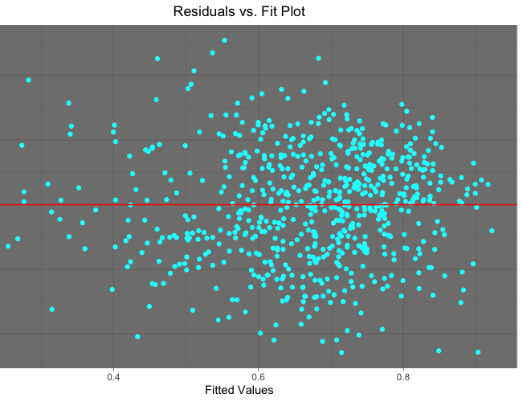
Residuals vs. Fit Plot
The Residuals vs. Fit plot appears to be well-behaved
It could be argued that there is a slight fanning pattern
For a starting model with more adjustments to be made it serves its purpose

Slide 11
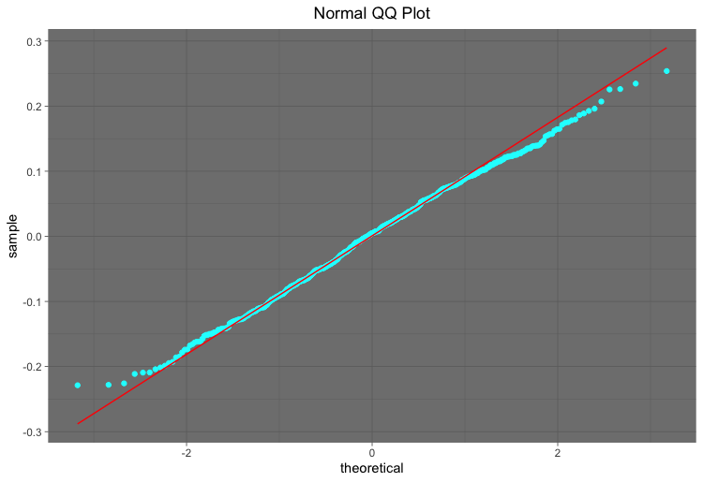
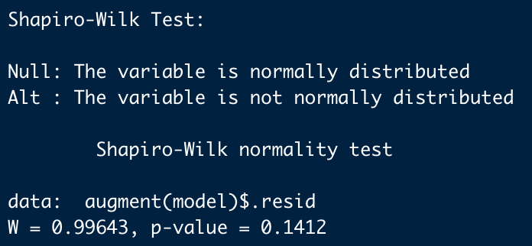
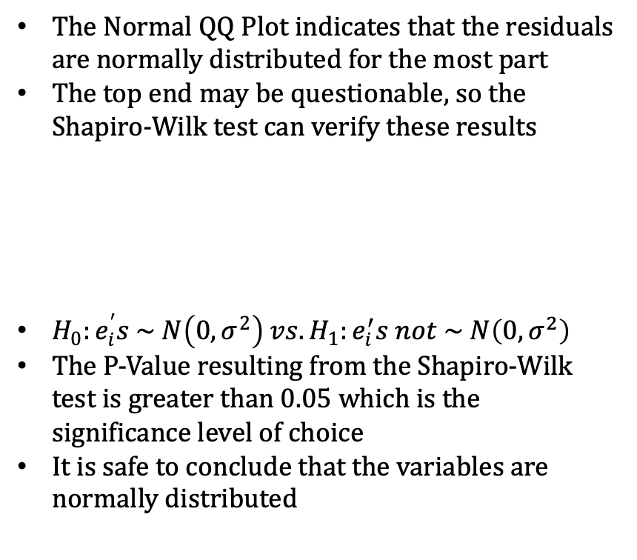
Assessing Normality:
The Normal QQ Plot indicates that the residuals are normally distributed for the most part
The top end may be questionable, so the Shapiro-Wilk test can verify these results
$H_{0}:e_{i}^{′}s \sim N\left(0, σ^{2}\right) vs. H_{1}:e_{i}^{′}s not \sim N\left(0, σ^{2}\right)$
The P-Value resulting from the Shapiro-Wilk test is greater than 0.05 which is the significance level of choice
It is safe to conclude that the variables are normally distributed

Slide 12
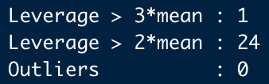
Residuals vs. Order and Influential Points
Regarding the assumption of independence, the data were scraped specifically so there would be no dependence on time
All audio features in the data are values for the overall track, not varying as the track progresses
While reconsidering the qualifications for influential points with the updated model, there are no potential outliers based on the studentized residuals
Further, there is only one leverage with a value larger than 3 times the mean
It appears to be safe to conclude that there are no influential data points for this model

Slide 13
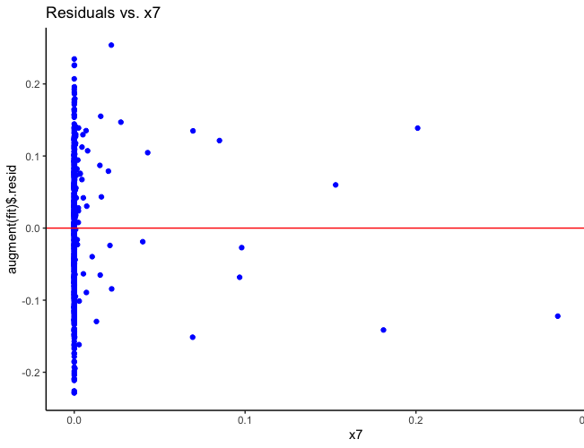
Residuals vs. x7
The final thing to take into consideration is if there is any possible relation with left out predictors
The plot indicates no strong patterns, meaning it is safe to leave x7 out of the model
Also, recall the scatterplot correlation matrix, x7 did not seem to have a relation with any other variables

Slide 14
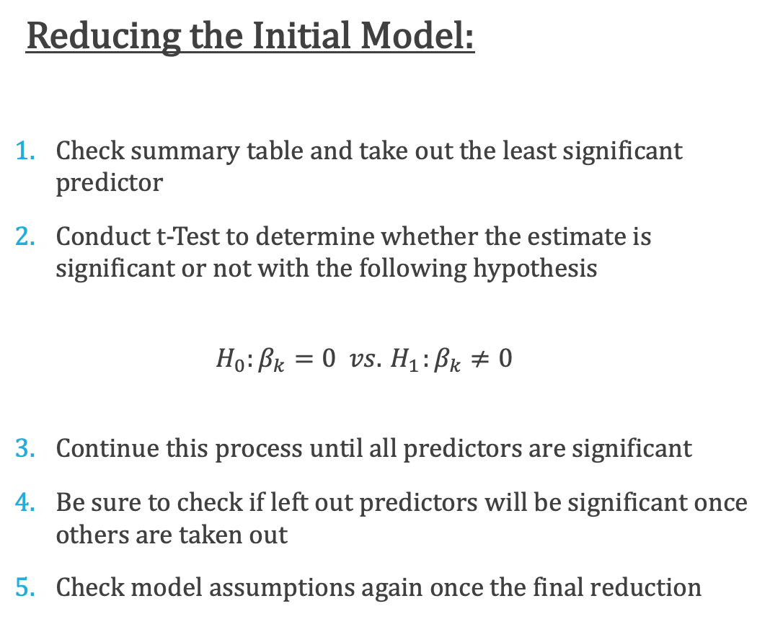
Recall the First Research Question:
Reducing the Initial Model:
Check summary table and take out the least significant predictor
Conduct t-Test to determine whether the estimate is significant or not with the following hypothesis
$$H_{0}:β_{k}=0 vs. { H}_{1}:β_{k}≠0$$
Continue this process until all predictors are significant
Be sure to check if left out predictors will be significant once others are taken out
Check model assumptions again once the final reduction
How can linear regression be implemented in order to understand what determines the overall energy in a track in the simplest manner?
Simple can be interpreted in different ways
For the scope of this project, simple will be defined as a first-order model including only significant predictors

Slide 15
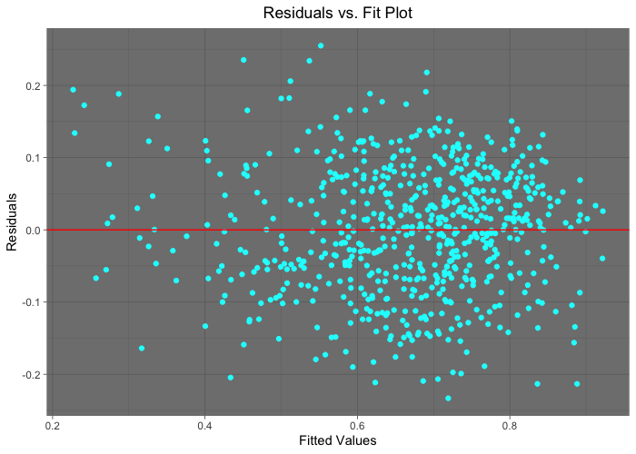
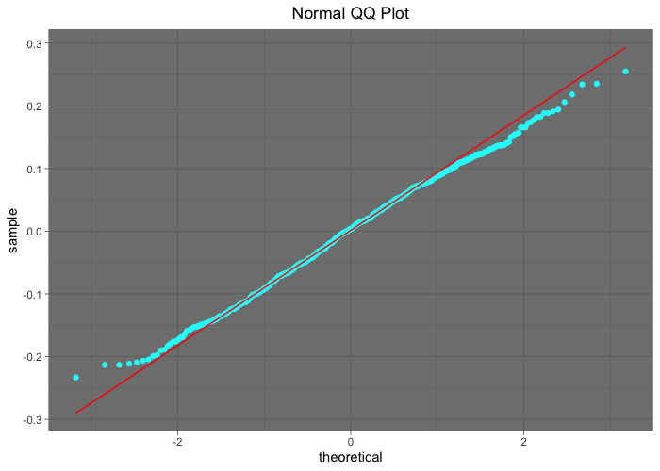
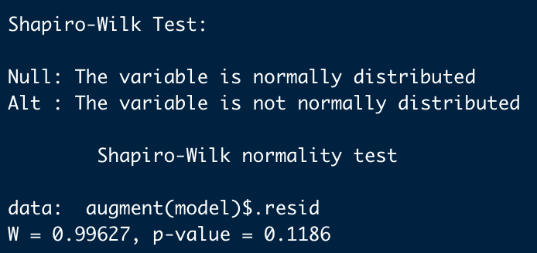
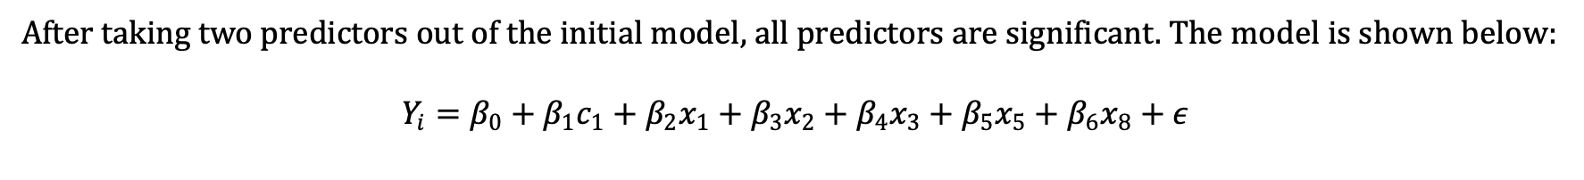
Reduced First-Order Linear Regression Model
After taking two predictors out of the initial model, all predictors are significant. The model is shown below:
$$Y_{i}=β_{0}+β_{1}c_{1}+β_{2}x_{1}+β_{3}x_{2}+β_{4}x_{3}+β_{5}x_{5}+β_{6}x_{8}+ε$$
The Residuals vs. Fit plot does not indicate any obvious issue with linearity or non-constant variance.
The Normal QQ Plot indicates that the residuals are normally distributed, the Shapiro-Wilk test can confirm.
The Shapiro-Wilk test concludes that the residuals are indeed normally distributed.

Slide 16
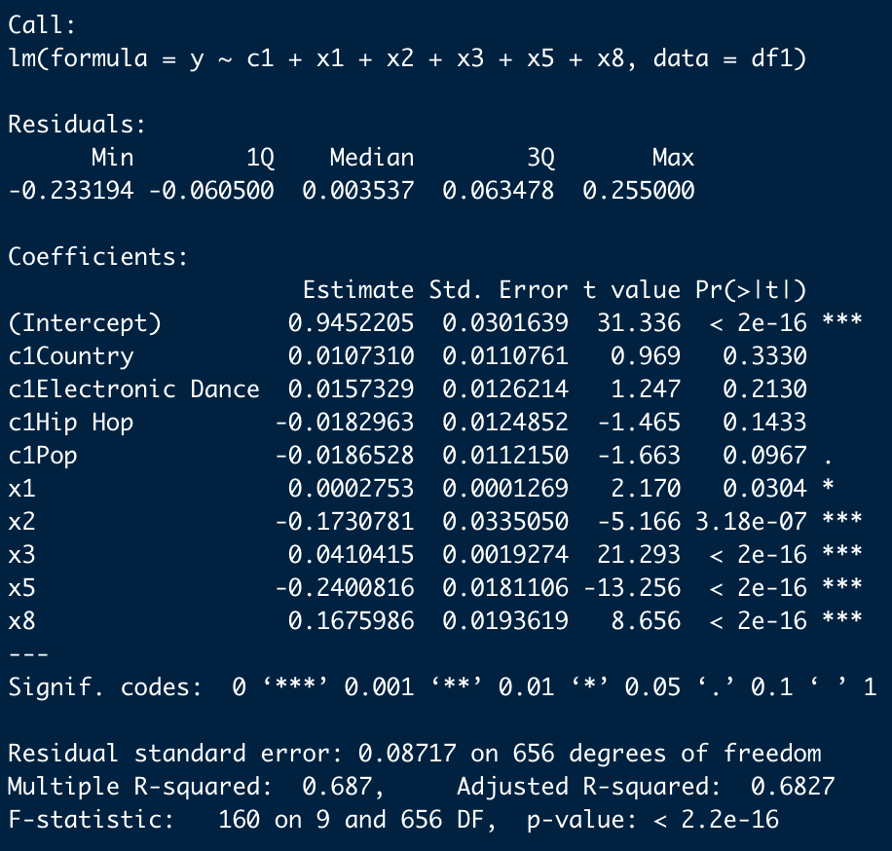
Interpretation of Significant Regression Coefficients
Recall:
c1 = genre, x1 = tempo, x2 = danceability, x3 = loudness, x5 = acousticness, x8 = valence
x1: For each additional beat per minute, the estimated average energy value increases by 0.0002753, provided all other predictors are held fixed.
x2: For each additional unit increase in the measure of danceability, the estimated average energy value decreases by 0.1731, provided all other predictors are held fixed.
x3: For each additional unit increase in loudness, the estimated average energy value increases by 0.04104, provided all other predictors are held fixed.
x5: For each additional unit increase in the measure of acousticness, the estimated average energy value decreases by 0.2401, provided all other predictors are held fixed.
x8: For each additional unit in valence, the estimated average energy value increases by 0.1676, provided all other predictors are held fixed.

Slide 17
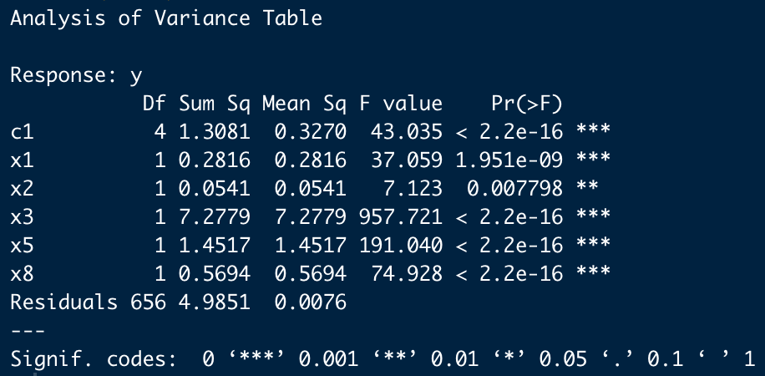
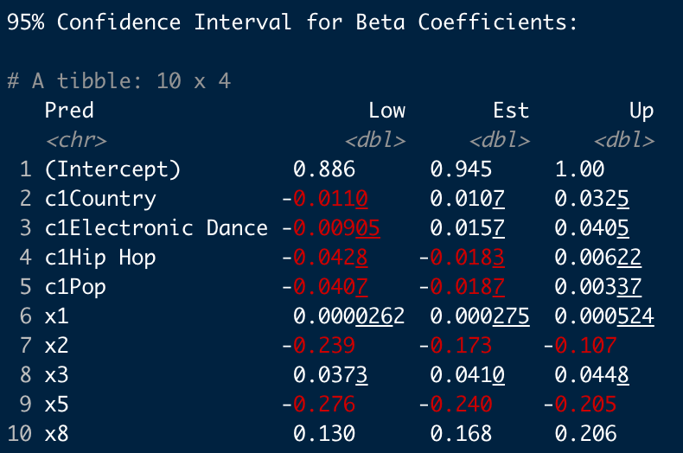
Inferences
ANOVA indicates that all predictors present in the model are significant
Notice that the sequential sum of squares for x3 accounts for 7.2779/15.9279 of the total error which is about 45.7%
Confidence Intervals for all the estimates, notice that for x2 has the widest interval
An interesting observation is that for all genres the confidence interval includes zero, yet it is considered an important predictor
This may be a good indicator of something to observe when searching for interactions

Slide 18
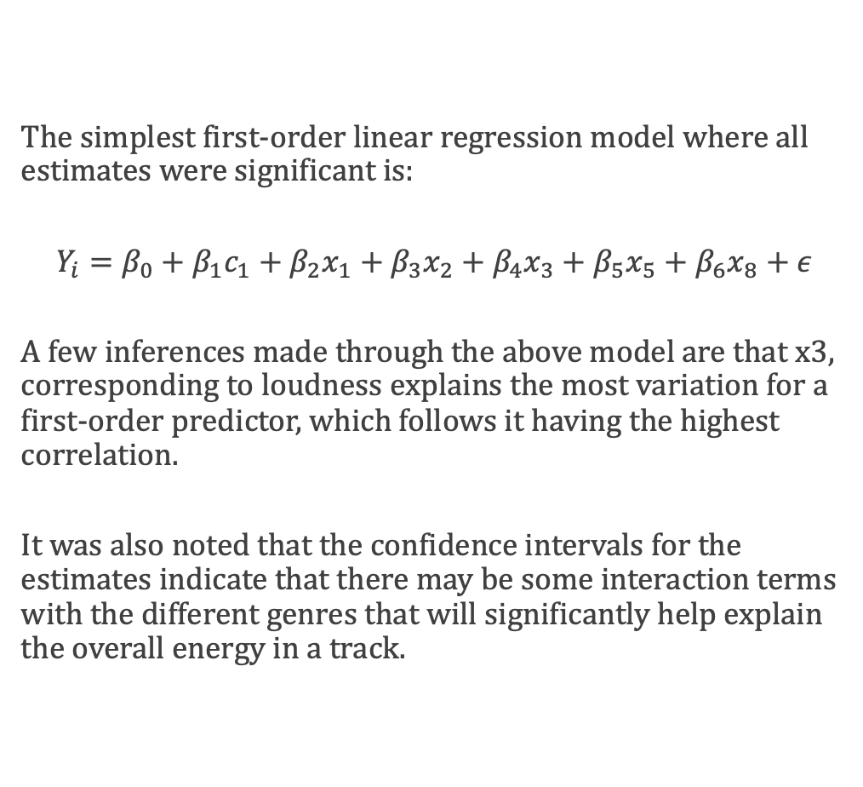
Answer to Research Question 1
The simplest first-order linear regression model where all estimates were significant is:
$$Y_{i}=β_{0}+β_{1}c_{1}+β_{2}x_{1}+β_{3}x_{2}+β_{4}x_{3}+β_{5}x_{5}+β_{6}x_{8}+ε$$
A few inferences made through the above model are that x3, corresponding to loudness explains the most variation for a first-order predictor, which follows it having the highest correlation.
It was also noted that the confidence intervals for the estimates indicate that there may be some interaction terms with the different genres that will significantly help explain the overall energy in a track.

Slide 19
Consider Research Question 2
Question:
What variable alone has the largest effect in magnitude on the overall energy in a song?
Proposed Solution:
From the first-order model, take out one predictor at a time and conduct the F-test
Pay attention to the sums of squares
The variable that leaves the analysis with the most residuals sum of squares will be our solution

Slide 20
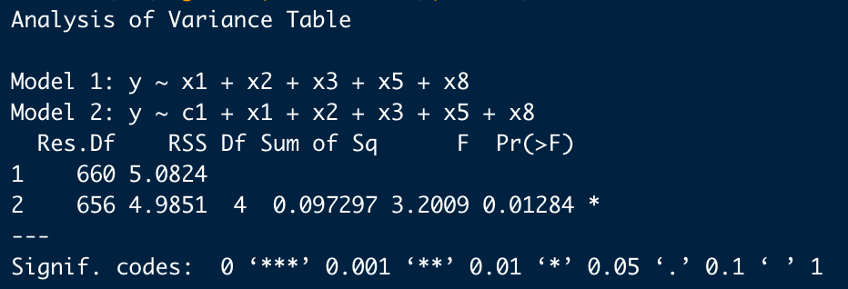
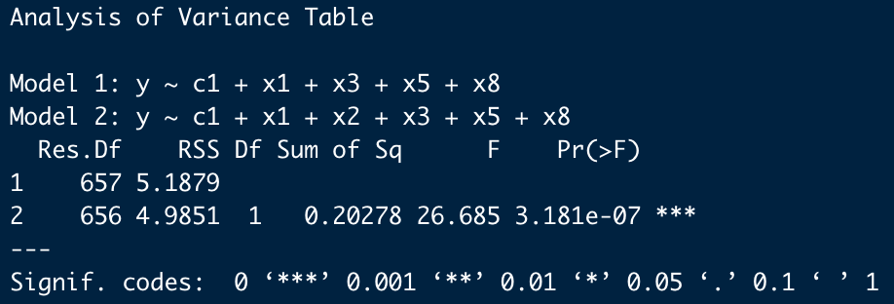
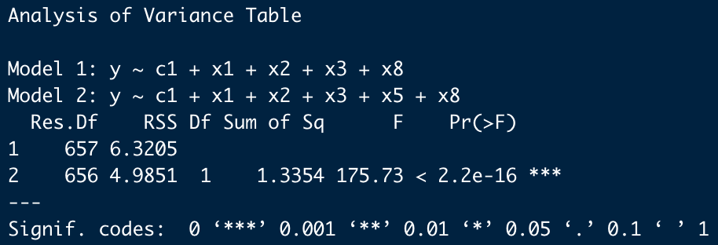
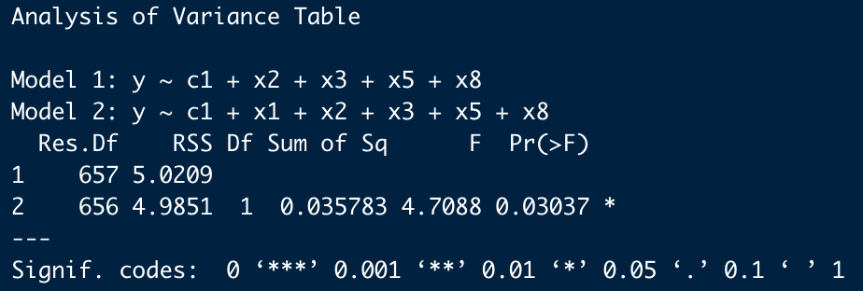
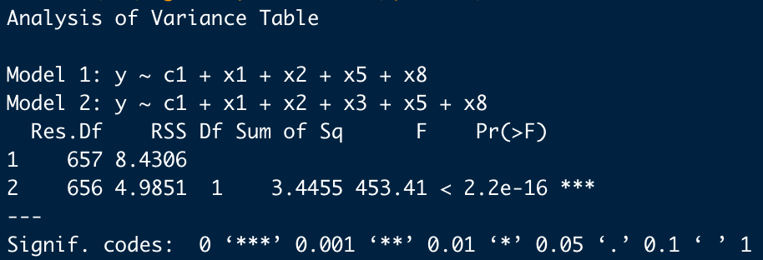
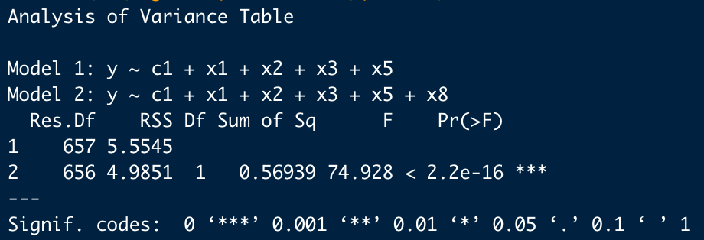
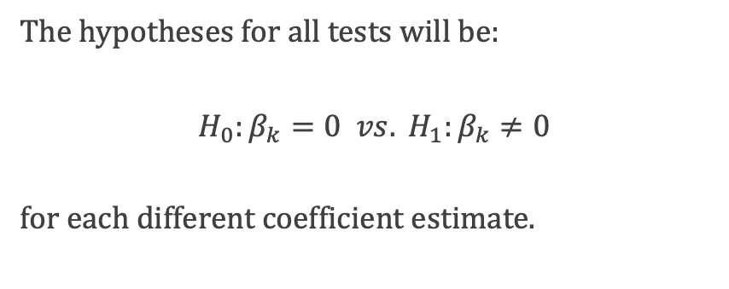
Leaving out c1 adds 0.0973 to residual sum of squares
Leaving out x2 adds 0.2028 to residual sum of squares
Leaving out x5 adds 1.3354 to residual sum of squares
Leaving out x1 adds 0.0358 to residual sum of squares
Leaving out x3 adds 3.4455 to residual sum of squares
Leaving out x8 adds 0.5694 to residual sum of squares
The hypotheses for all tests will be:
$$H_{0}:β_{k}=0 vs. H_{1}:β_{k}≠0$$
for each different coefficient estimate.
F – Test for a Single Slope Parameter

Slide 21
Answer to Research Question 2
Leaving the predictor x3 out adds 3.4455 out of 15.9279 total sum of squares to the residuals. x3 = loudness definitely has the largest effect on energy

Slide 22
Consider Research Question 3
Question:
Disregarding simplicity, are there any interactions in the data that contribute to understanding the energy in a track? If so, are they intuitive?
Proposed Solution:
Screen all possible interaction effects with the F-test
Update model by adding the most significant interaction one at a time
Continue this process until there are no significant interactions left
Make inferences to answer the desired question

Slide 23
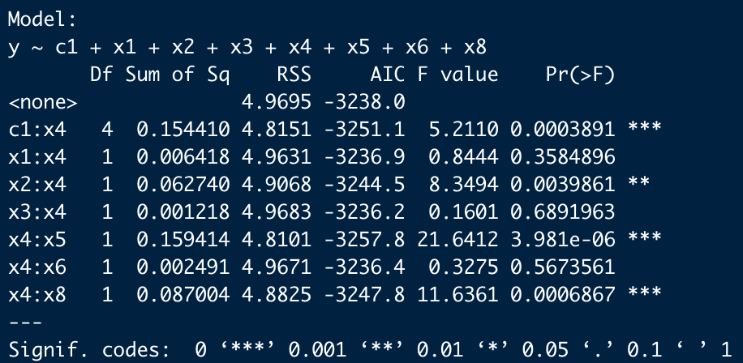
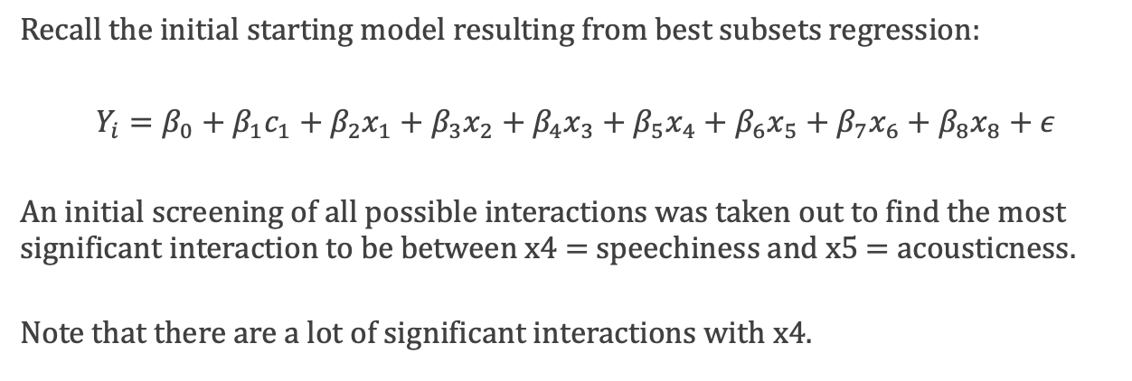
Recall the initial starting model resulting from best subsets regression:
$$Y_{i}=β_{0}+β_{1}c_{1}+β_{2}x_{1}+β_{3}x_{2}+β_{4}x_{3}+β_{5}x_{4}+β_{6}x_{5}+β_{7}x_{6}+β_{8}x_{8}+ε$$
An initial screening of all possible interactions was taken out to find the most significant interaction to be between x4 = speechiness and x5 = acousticness.
Note that there are a lot of significant interactions with x4.
Screening Interaction Terms

Slide 24
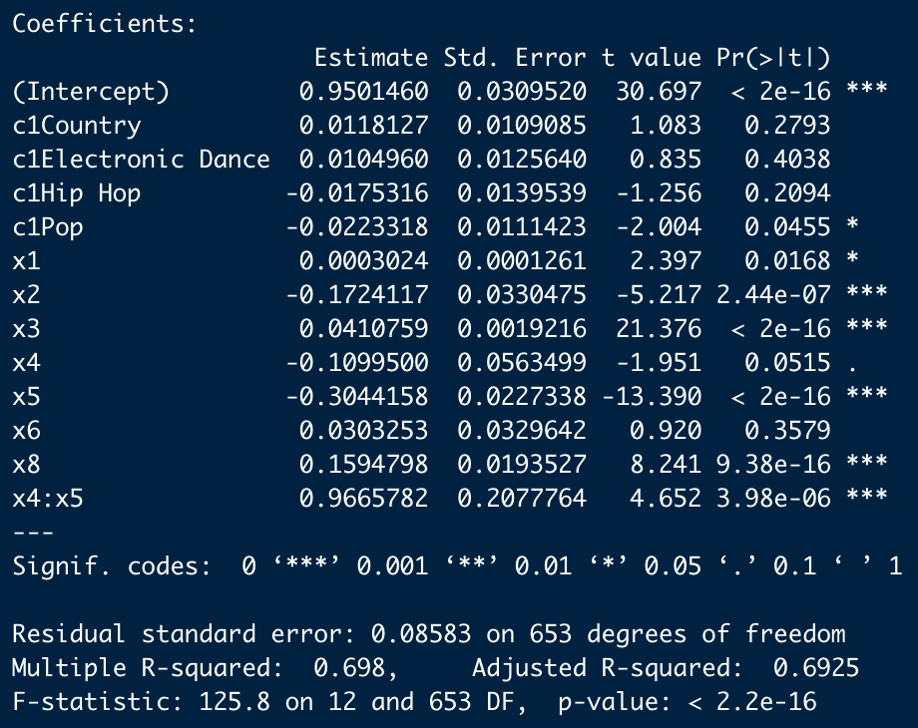
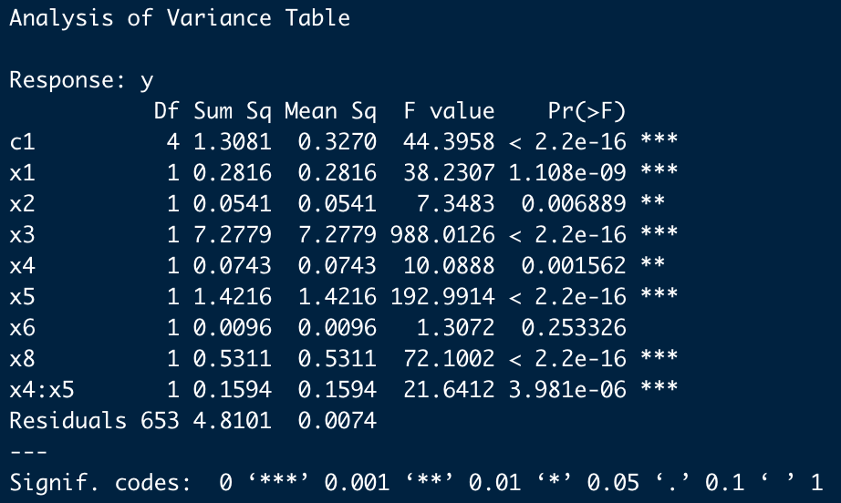

$$Y_{i}=β_{0}+β_{1}c_{1}+β_{2}x_{1}+β_{3}x_{2}+β_{4}x_{3}+β_{5}x_{4}+β_{6}x_{5}+β_{7}x_{6}+β_{8}x_{8}+β_{9}x_{5}x_{6}+ε$$
$$R_{a}^{2}=0.6925$$
Summary and ANOVA of Updated Model

Slide 25
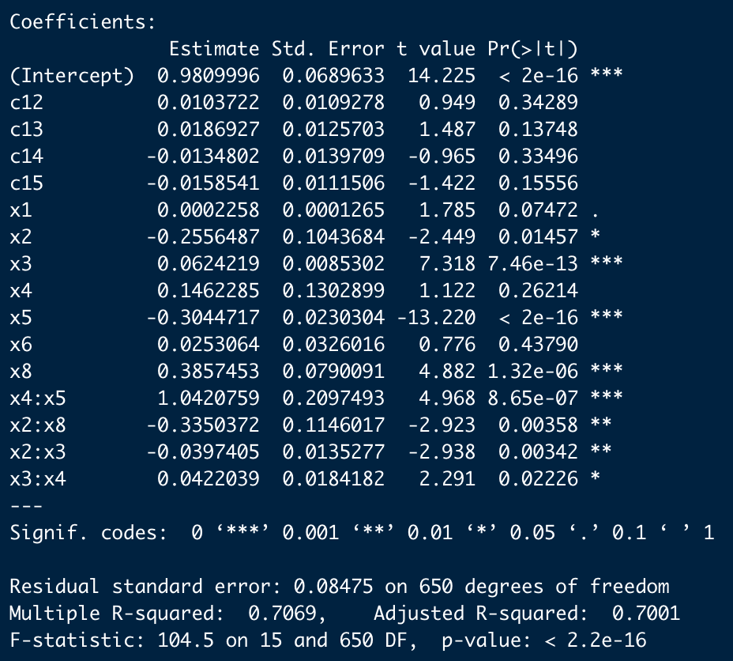
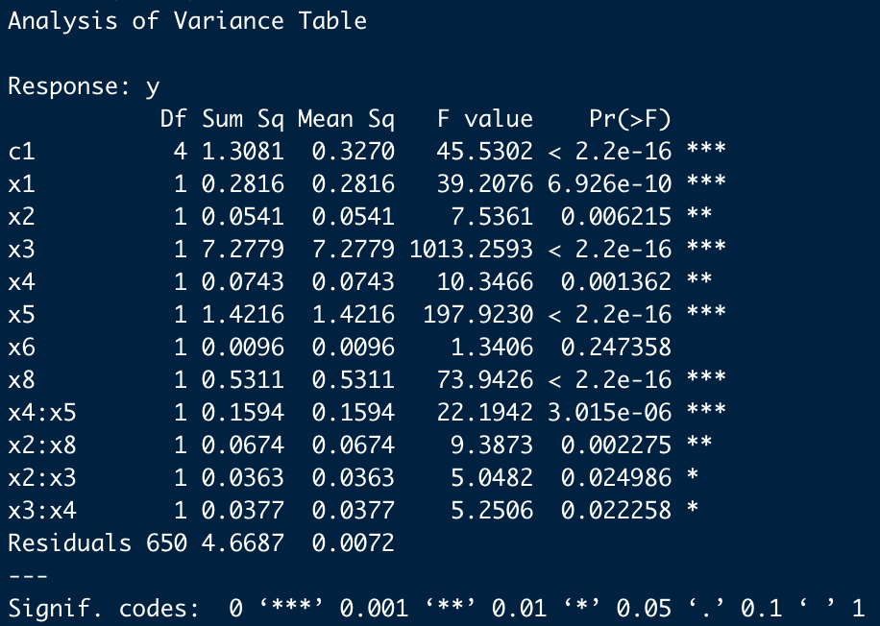
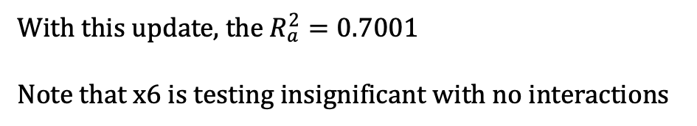
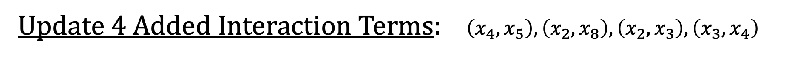
Update 4 Added Interaction Terms: $\left(x_{4}, x_{5}\right), \left(x_{2}, x_{8}\right), \left(x_{2}, x_{3}\right), \left(x_{3}, x_{4}\right)$
With this update, the $R_{a}^{2}=0.7001$
Note that x6 is testing insignificant with no interactions

Slide 26
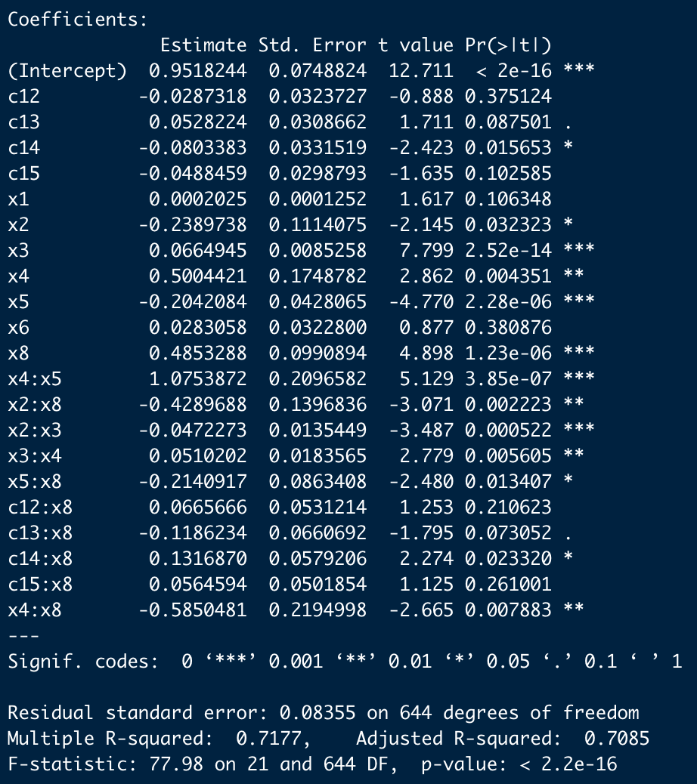
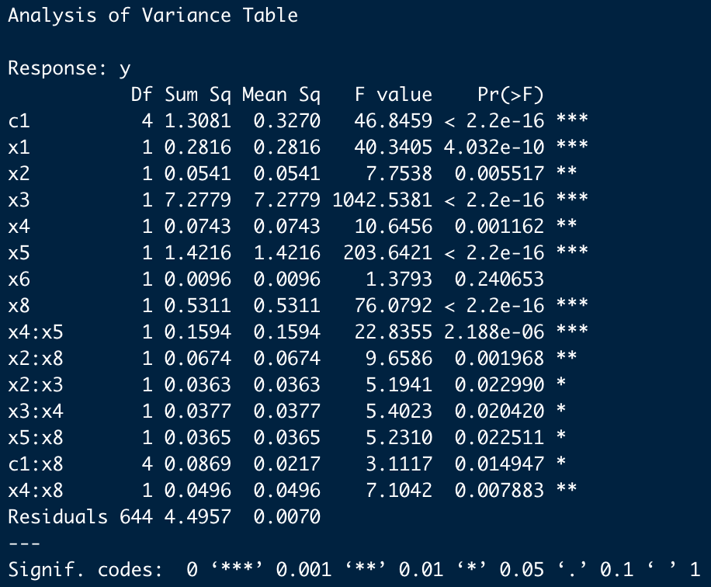
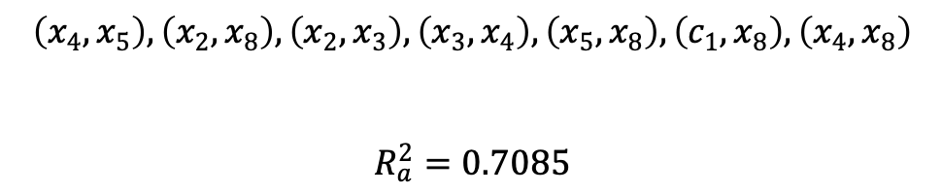
Update 7 Interactions:
$$\left(x_{4}, x_{5}\right), \left(x_{2}, x_{8}\right), \left(x_{2}, x_{3}\right), \left(x_{3}, x_{4}\right), \left(x_{5}, x_{8}\right), \left(c_{1}, x_{8}\right), \left(x_{4}, x_{8}\right)$$
$$R_{a}^{2}=0.7085$$

Slide 27
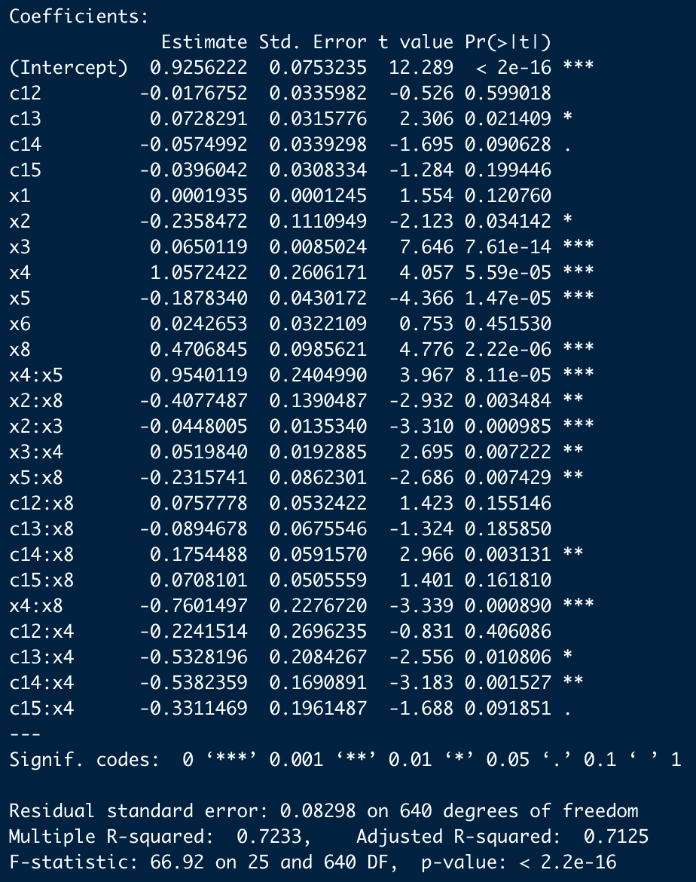
Final Model Before Reduction:
The predictors x1 and x6 are both insignificant resulting from the t-test and they both are not part of any interaction effects
x4 and x8 are part of four interaction effects each
Recall that x4 alone was not significant in the model consisting of only first-order terms
This is a very complicated model that can likely become more complicated considering how much x4 and x8 interact with other variables

Slide 28
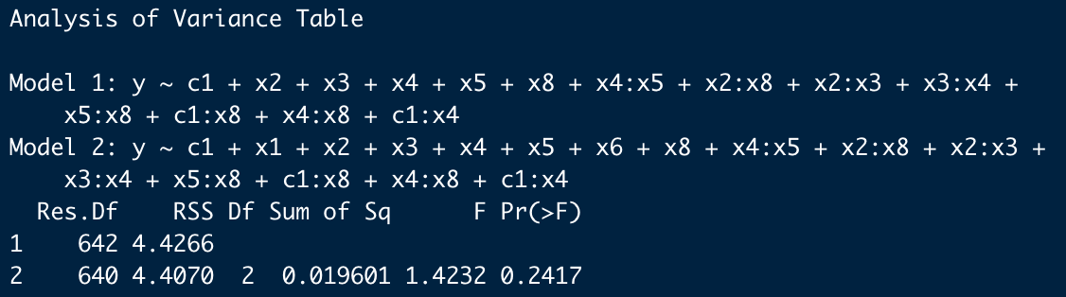
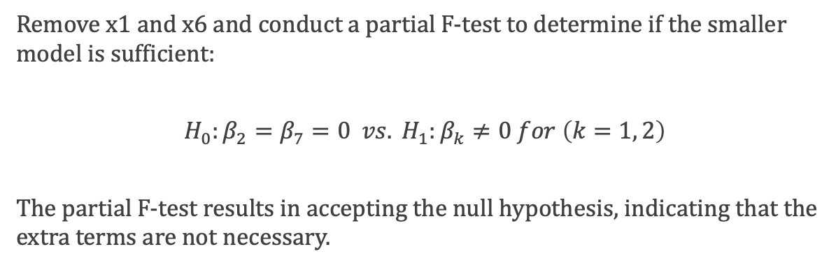
Remove x1 and x6 and conduct a partial F-test to determine if the smaller model is sufficient:
$$H_{0}:β_{2}=β_{7}=0 vs. H_{1}:β_{k}≠0 for \left(k=1, 2\right)$$
The partial F-test results in accepting the null hypothesis, indicating that the extra terms are not necessary.
Reduce Model to Only Contain Significant Estimates

Slide 29
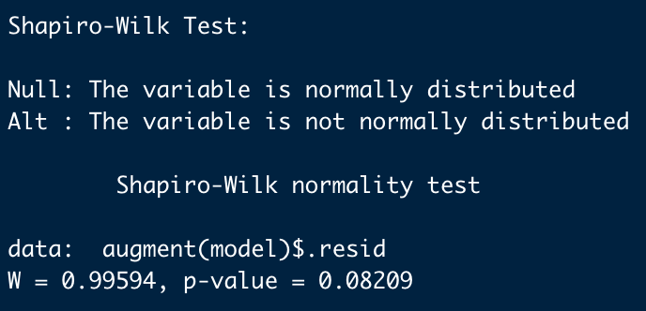

Residual Analysis:
The residuals appear to be normally distributed in the normal QQ plot
The Shapiro-Wilk test confirms that the residuals are normally distributed
Residuals vs. Fit plot does not indicate any issues with non-linearity or non-constant variance
Since the assumptions are satisfied, the model is safe to use for inference and prediction

Slide 30


The Model By Genres:
Alternative/Reggae
$${\hat{Y}}_{i}=0.96−0.25x_{2}+0.07x_{3}+1.09x_{4}−0.19x_{5}+0.48x_{8}+0.94x_{4}x_{5}−0.42x_{2}x_{8}−0.05x_{2}x_{3}+0.06x_{3}x_{4}−0.23x_{5}x_{8}−0.75x_{4}x_{8}$$
Country
$${\hat{Y}}_{i}=0.94−0.25x_{2}+0.07x_{3}+0.88x_{4}−0.19x_{5}+0.56x_{8}+0.94x_{4}x_{5}−0.42x_{2}x_{8}−0.05x_{2}x_{3}+0.06x_{3}x_{4}−0.23x_{5}x_{8}−0.75x_{4}x_{8}$$
Electronic Dance
$${\hat{Y}}_{i}=1.04−0.25x_{2}+0.07x_{3}+0.56x_{4}−0.19x_{5}+0.39x_{8}+0.94x_{4}x_{5}−0.42x_{2}x_{8}−0.05x_{2}x_{3}+0.06x_{3}x_{4}−0.23x_{5}x_{8}−0.75x_{4}x_{8}$$
Hip Hop
$${\hat{Y}}_{i}=0.9−0.25x_{2}+0.07x_{3}+0.55x_{4}−0.19x_{5}+0.66x_{8}+0.94x_{4}x_{5}−0.05x_{2}x_{3}+0.06x_{3}x_{4}−0.23x_{5}x_{8}−0.75x_{4}x_{8}$$
Pop
$${\hat{Y}}_{i}=0.92−0.25x_{2}+0.07x_{3}+0.76x_{4}−0.19x_{5}+0.55x_{8}+0.94x_{4}x_{5}−0.42x_{2}x_{8}−0.05x_{2}x_{3}+0.06x_{3}x_{4}−0.23x_{5}x_{8}−0.75x_{4}x_{8}$$

Slide 31
Interpretation of Numeric Interaction Effects
(x4, x5): For a one unit increase in x4, the average energy is expected to change by 1.088 + 0.94x5, while for a one unit increase in x5, the average energy is expected to change by -0.189 + 0.94x4, provided all other predictors remain fixed for both cases.
(x2, x8): For a one unit in x2, the average energy is expected to change by -0.252 – 0.423x8, while for a one unit increase in x8, the average energy is expected to change by 0.484 – 0.423x2, provided all other predictors remain the same in each case.
(x2, x3): For a one unit in x2, the average energy is expected to change by -0.252 – 0.047x3, while as for a one unit increase in x3, the average energy is expected to change by 0.066 – 0.047x2, provided all other predictors remain the same in each case.
(x3, x4): For a one unit increase in x3, the average energy is expected to change by 0.066 + 0.056x4, while as for a one unit increase in x4, the average energy is expected to change by 1.088 + 0.056x3, provided all other predictors remain the same in each case.
(x5, x8): For a one unit increase in x5, the average energy is expected to change by -0.189 – 0.229x8, while as for a one unit increase in x8, the average energy is expected to change by 0.484 – 0.229x5, provided all other predictors remain the same in each case.
(x4, x8): For a one unit increase in x4, the average energy is expected to change by 1.088 – 0.749x8, while as for a one unit increase in x8, the average energy is expected to change by 0.484 – 0.749x4, provided all other predictors remain the same in each case.
Note: x2 = danceability, x3 = loudness, x4 = speechiness, x5 = acousticness, x8 = valence
(x4, x5)
(x2, x8)
(x2, x3)
(x3, x4)
(x5, x8)
(x4, x8)

Slide 32


Confidence Intervals for $β$ Coefficient Estimates
Every confidence interval for estimates consisting of numeric predictors only does not cover zero
The confidence intervals for one of the genres, 3 corresponds to Electronic Dance Music after recoding, does not cover zero unlike before interactions were involved
The categorical interactions have more significant levels as well

Slide 33
Answer to Research Question 3
A straightforward answer to the question is yes, there are interactions in the data that contribute to the understanding of energy in a song
(x4x5): speechiness and loudness, this can be unintuitive, but think of it like the lyrics in a song need to be heard over the music
(x2x8): loudness and valence, this is not so intuitive, my thoughts are that this is more so effected by other variables
(x2x3): danceability and loudness, this is intuitive, if you were to think of a place where a lot of people dancing you would likely image loud music as well
(x3x4): loudness and speechiness, this is intuitive if you consider that if you can hear lyrics in a song then they would need to be loud enough to be heard over the sounds
(x5x8): acousticness and valence, this is intuitive in the sense that acoustic sounds are very good and setting emotional moods
(x4x8): speechiness and valence, this is intuitive because sending a positive message would be easier with lyrics since it could be directly interpreted through words

Slide 34
Closing Comments
Energy in music is very complex with many relationships to other audio features
There are likely more interaction terms of higher order with consideration of the table below showing all interactions between numeric variables
(Number correspond to the subscripts on x)
Energy may be very different for genres of music that have more acoustic sounds from instruments and a band rather than sounds produced in a studio
2 | 3 | 4 | 5 | 8
3 | 2 | 3 | 4 | 2
8 | 4 | 5 | 8 | 4
 |  | 8 |  | 5

Slide 35




Dr. Liao and students of STAT 510,
THANK YOU FOR LISTENING!!
I hope you enjoyed.
Joey Gadbois
Code will by on GitHub shortly for anyone interested:
github.com/jgadbois17

